Slide 1
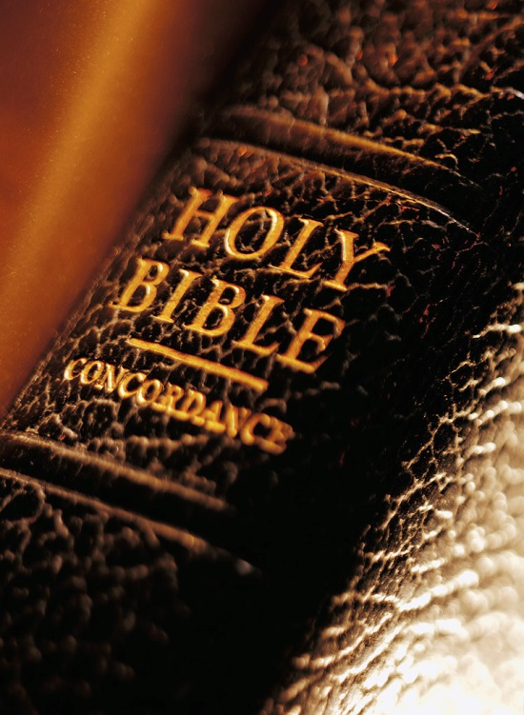
Expository Excerpts From Acts 2
(Acts 2:42-47)
Fervor of the Early Church
qualities of the disciples (3)
All Verses Are From The NKJV Unless Noted

Slide 2
Acts 2 Broken Down
2:1-11 – God Keeps His Promises
2:12, 13 – Man’s Slow Heart
2:14-36 – Wisdom in Answering Critics
2:37-41 – The Desired Effect and Plan
2:42-47 – The Fervor of the Early Church
The steadfast practice (2:42)
The qualities of the disciples (2:43-46)
FEAR
UNITY
?

Slide 3
3

Slide 4
“Now all who believed were together, and had all things in common, and sold their possessions and goods, and divided them among all, as anyone had need” (2:44, 45)
A togetherness with compassion
Funds distributed to needy saints
Beginning of the pattern on benevolence revealed (Acts 4:34, 35; 6:1-8; 11:27-30; etc.)

Slide 5
“Benevolence”– LIMITED!
People today view the church as a place where they can receive financial help when their budget tightens
No passage in scripture shows the church is to be a welfare agency to the poor of the world
No passage exists that suggests the church ever gave monetary help to a non-Christian
No authority for churches to build benevolent institutions for the needy of the world
Limitations were placed—even on widows (1 Tim. 5:1-16)
Individuals may help as they wish (Mk. 14:3-7)

Slide 6
Pride & greed (Ps. 10:1-11)
Compulsion (2 Cor. 9:7; Phlm. 1:8-14)
Laziness (2 Th. 3:10)
Of a potential giver (Eph. 4:28)
Abuse of a receiver (Prov. 30:15, 16)
To be seen of men (Acts 5:1ff; Matt. 6:2-4)

Slide 7
God GAVE His Son To Save You!
John 3:16; 4:10 | Romans 5:15; 6:23 | 2 Corinthians 8:9

Slide 8
Will You ENTRUST Your Soul To God Today?
1Peter 4:18, 19, Now "If the righteous one is scarcely saved, Where will the ungodly and the sinner appear?" Therefore let those who suffer according to the will of God commit their souls to Him in doing good, as to a faithful Creator.

Slide 9
Do You Believe?
In REPENTANCE
“Truly, these times of ignorance God overlooked, but now commands all men everywhere to repent” (Acts 17:30)

Slide 10
Do You Believe?
In CONFESSION
“because He has appointed a day on which He will judge the world in righteousness by the Man whom He has ordained. He has given assurance of this to all by raising Him from the dead” (Acts 17:31)
Resurr. → Son of God (Rom. 1:4)
Believe in Resurr. → Confess Lord (Rom. 10:9)

Slide 11
Do You Believe?
In BAPTISM
“Or do you not know that as many of us as were baptized into Christ Jesus were baptized into His death?” (Rom. 6:3)
Bapt. → Christ
Baptism Is INTO God’s Gift!
Bapt. → Death
To reject baptism is to reject God’s charity!

